Slide 1
Housing in Madison
Annie Zheng

Slide 2
Motivation
U.S’s economy is expanding right now. How does this affect Madison’s housing?
Even though residential property build in 2017 is only 29.0% of residential property build in 2004, it has doubled ever since the great depression of 2009.
Should you buy a new home or an older home? Or how tax for residential properties changes depending on the year build?
How much of the property tax comes from new development? And what kinds of properties are in new development?

Slide 3
Overview
Housing price
Number of houses build from 1837 to 2017
Relationship between Total Net Tax and year build for houses
Take a look at some of interesting variables selected from Lasso
Understand how the value of Madison’s residential properties change over time
Net tax for different property class and wards

Slide 4
Data (Where did I get it? And what is in it?)
Madison’s public website
The data contains the value for Madison’s property, taxes, ward, year build, Property Class, ect
There are zero as a year(what are in year zero?)
Industry and Commercial only has zero year
In this presentation, we will mainly explore residential property, which only has 0.5% of net tax from zero year

Slide 5
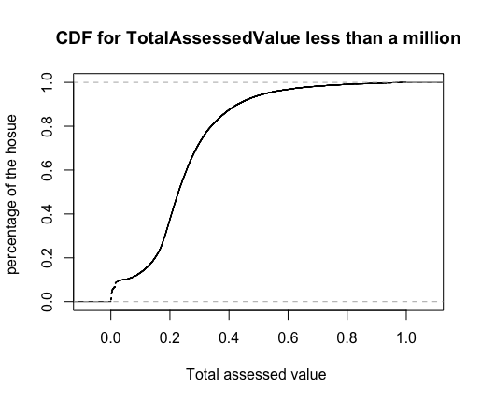
Overview of housing price
Interpretation of the red line:
Median house value in
Madison has a total assessed
Value of around $224,400.
This is slightly lower than the
national median of $ 226,300.

Slide 6
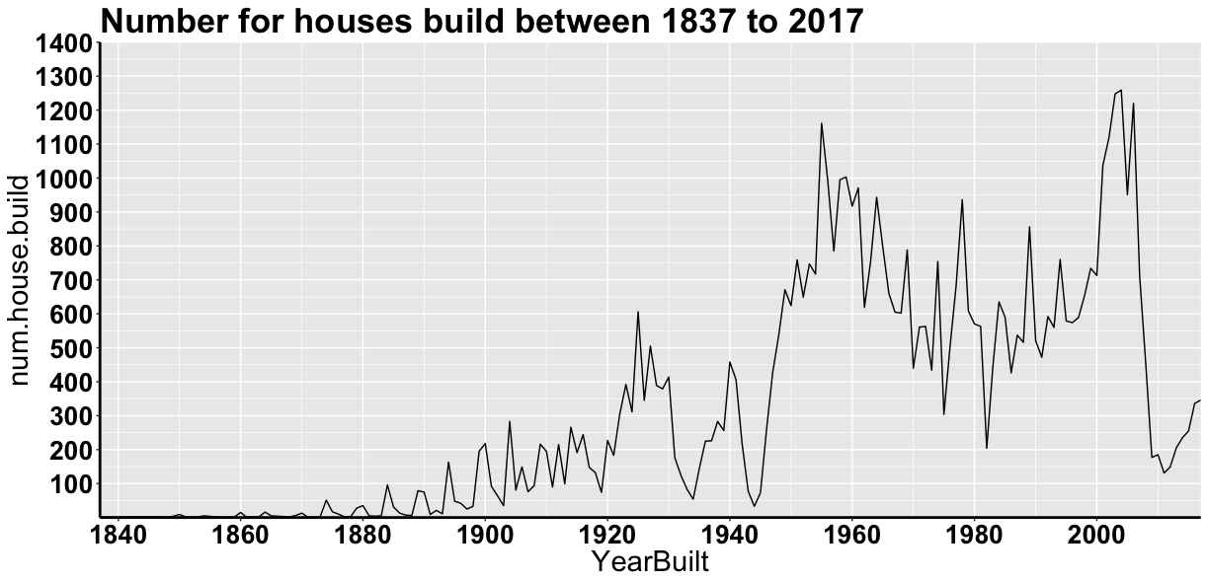
Zero year is excluded, only account of 0.5% of net tax

Slide 7
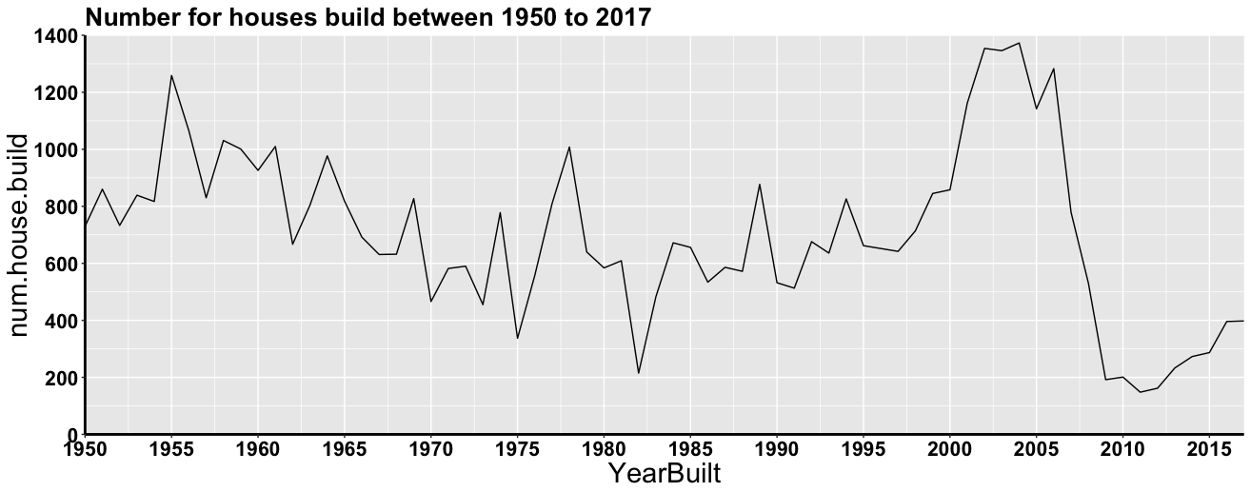
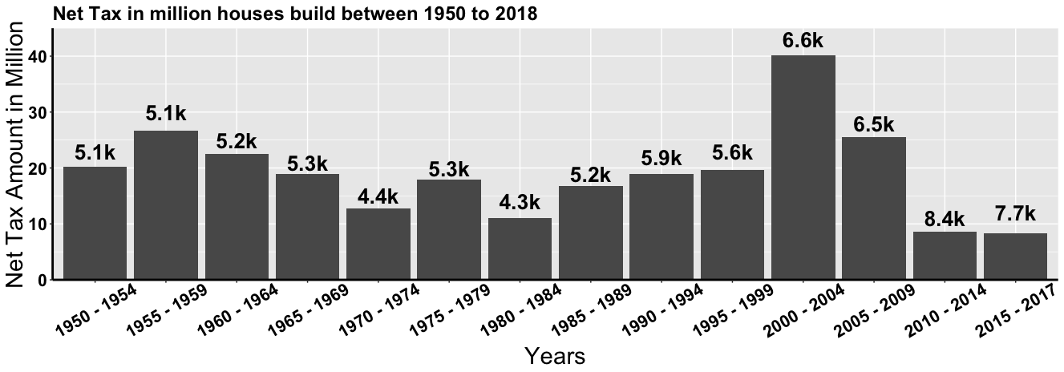
Residential property contains houses and condos
Residential houses build in 2017 is only 29% of the houses build in 2004 and double of the houses build in 2009(great depression)
4.52% of total net tax came from residential property build in 2010 to 2017
New property (2010 – 2017 )are all residential

Slide 8
Variables Given in the Dataset
Address
DateParcelChanged
PropertyClass
YearBuilt
AssessedByState
CurrentLand
CurrentImpr
CurrentTotal
PreviousLand
PreviousImpr
PreviousTotal
NetTaxes
SpecialAssmnt
OtherCharges
TotalTaxes
Ward
StateAssemblyDistrict
PreviousLand2
PreviousImpr2
PreviousTotal2
HouseNbr
StreetDir
StreetName
StreetID

Slide 9
Variables Chosen by Lasso
Address
DateParcelChanged
PropertyClass
YearBuilt
AssessedByState
CurrentLand
CurrentImpr
CurrentTotal
PreviousLand
PreviousImpr
PreviousTotal
NetTaxes
SpecialAssmnt
OtherCharges
TotalTaxes
Ward
StateAssemblyDistrict
PreviousLand2
PreviousImpr2
PreviousTotal2
HouseNbr
StreetDir
StreetName
StreetID

Slide 10
Interesting Variables we are going to look at
Address
DateParcelChanged
PropertyClass
YearBuilt
AssessedByState
CurrentLand
CurrentImpr
CurrentTotal
PreviousLand
PreviousImpr
PreviousTotal
NetTaxes
SpecialAssmnt
OtherCharges
TotalTaxes
Ward
StateAssemblyDistrict
PreviousLand2
PreviousImpr2
PreviousTotal2
HouseNbr
StreetDir
StreetName
StreetID

Slide 11
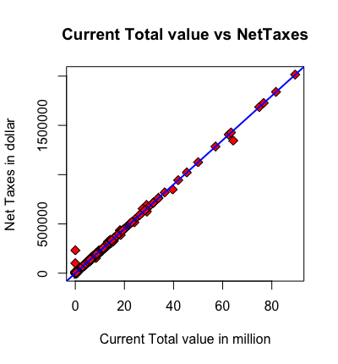
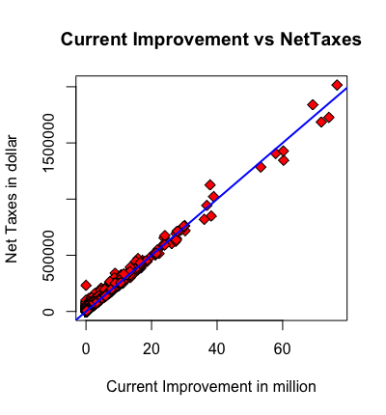
Variable: CurrentImpr and CurrentTotal
Correlation: 0.9455
Correlation: 0.9455

Slide 12
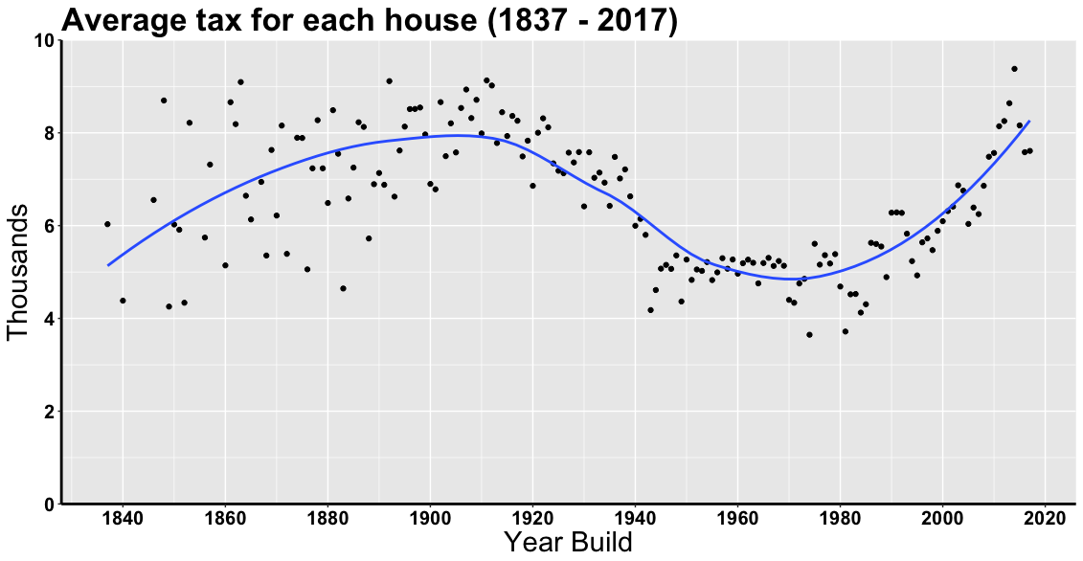
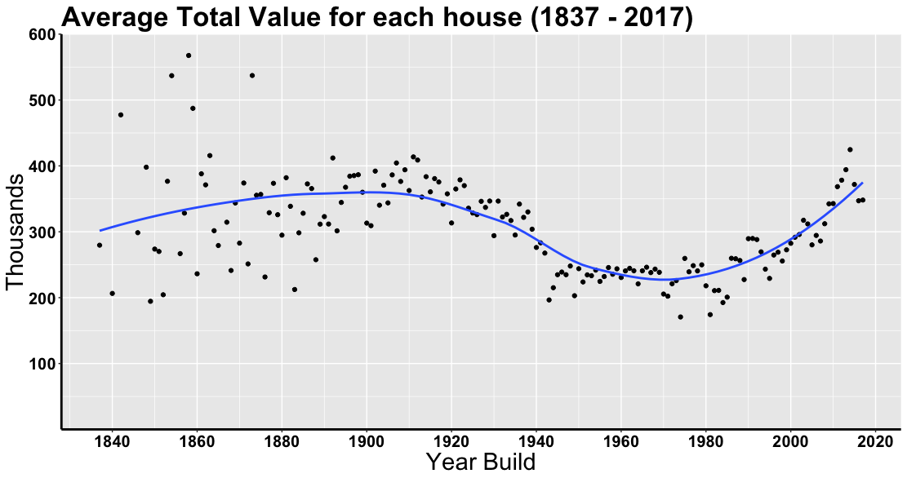
Variable: YearBuild
Main Observations
There are more variance in older houses’
average tax and average total value.
Houses build between 1880 and 1920 have
an almost equivalent average tax and
average total value as new properties.
Average net tax and average total value
for properties after 1980 are growing at
an almost linear rate.
Measured in 2019 currency.

Slide 13
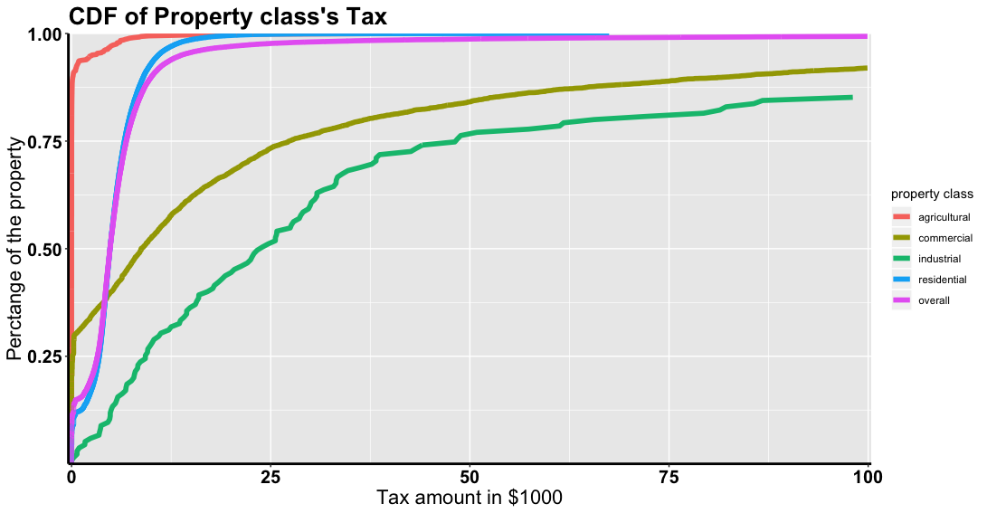
Variable: Property Class
Property Class
Agricultural
Commercial
Industrial
Residential
Overall
1042 properties are not
Included in this plot.
Meaning they have net
Tax larger than $100,000
Property class | Agricultural | Commercial | Industrial | Residential | Overall
Counts | 1452 | 6239 | 135 | 72369 | 80195
Median Tax in $ | 2.39 | 8738.97 | 23942.01 | 4826.03 | 4826.03

Slide 14
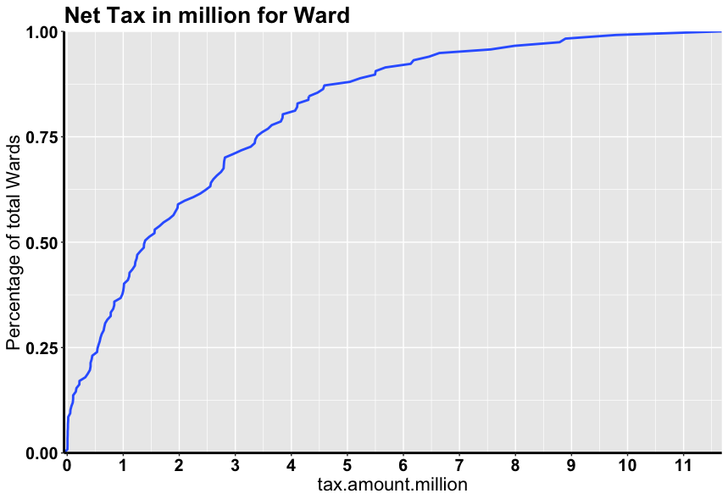
Variable: Ward
What is a Ward?
A ward is a local authority area, typically
used for electoral purposes. (equivalent to
neighborhood). There are 136 wards in
Madison. This plot only used house build after 1949
because there are some change in ward after 1949.
Interpretation of the orange line:
Median amount of Net Tax paid for Wards is
1.39 Millions
Why is this important?
There is ward pay up to 11.62 millions and ward pay
As little as 0.0039 millions. So it is important to
differentiate between wards.

Slide 15
Ward 106 with highest
Net tax of 11.62 M
and has 1263 properties
Ward 114 with lowest
Net tax of 0.0039 M
and has 1 properties
Ward 47 with highest
mean net tax of
0.027 M, sum net tax
0f 0.054 M and has
2 properties
Ward 74 with lowest
mean net tax of
0.0029 M, sum net tax
0f 0.61 M and has
213 properties, built
around 1980s.

Slide 16
Take away points
Housing market in Madison is slowly recovering from the Great depression, so the number of property built is doubled.
Value of houses around early 1900s are greater but has higher variance.
Even though not many houses are built in recent years, they are increasing in average total value and have higher net tax
Residential properties have the most influence on the overall net tax

